Slide 1
TensorFlow Features in Images
COMP 4230

Slide 2
ALERTS
Turn in work for Lab 1 by Friday
Read Chapter 3

Slide 3
Debrief: Lab 0 & Lab 1
What is your impression of TensorFlow at this point?
What questions do you have about these labs?
Specifically about the individual tasks?
Any technical issues using it?
So if you had to explain to someone what a neural network is doing, based on these labs how would you do it?
One way to answer this would be in terms of regression & classification

Slide 4
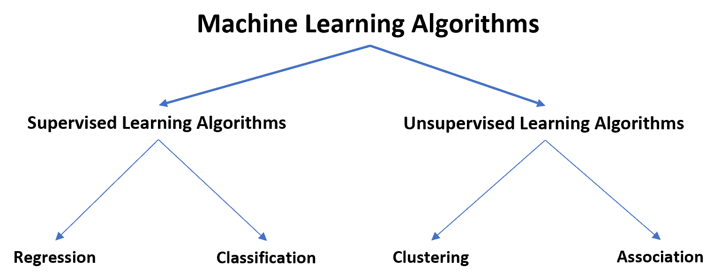
Machine Learning

Slide 5
Machine Learning: Regression vs. Classification
A regression model seeks to predict a continuous quantity
A real valued function (3n+1)
Height, weight, volume, etc.
Cost
Time
For example, if we have a dataset containing age, number of jobs held, and income we could fit a regression model that predicts income from the other two variables
A classification model seeks to predict a categorical quantity
Male or female
Shoes, hats, shirts, pants, etc.
Low, medium, high
Freshman, Sophomore, Junior, Senior
For example, if we have a dataset containing batting average, home runs, and runs batted in data for baseball players we could fit a classification model that predicts their being signed by the MLB

Slide 6
Similarities: Regression vs. Classification
Both are supervised learning algorithms, i.e. they both involve a response variable (target output of training).
Both use one or more explanatory variables (input to training) to build models to predict some response.
Both can be used to understand how changes in the values of explanatory variables affect the values of a response variable.

Slide 7
Differences: Regression vs. Classification
Regression algorithms seek to predict a continuous quantity and classification algorithms seek to predict a class category or label.
The way we measure the accuracy of regression and classification models differs.
Regression uses continuous metric based in the differences between target and actual output (e.g., root mean squared error)
Classification uses discrete percentage of correct cases relative to all cases

Slide 8
TensorFlow: Detecting Features in Images
In the Fashion MNIST example we trained a network to recognize fixed-size, statically positioned, greyscale images. It performed moderately well
In the real world images are messier (how?)
What aspects of real-world images would our neural network design find challenging to learn?
We will develop some additional tools that allow feature extraction to become possible in our models

Slide 9
Image science 101: Convolutions
How are digital images stored?
So it is convenient to think of images as 2D matrices of numbers (or 3D for color images)
If you've ever worked with Photoshop you know that there are a large collection of filters and algorithms that can be applied to an image to transform how it looks
Mathematically, these are most often linear algebra (or matrix) operations
A convolution is a specific type of matrix-based filter

Slide 10
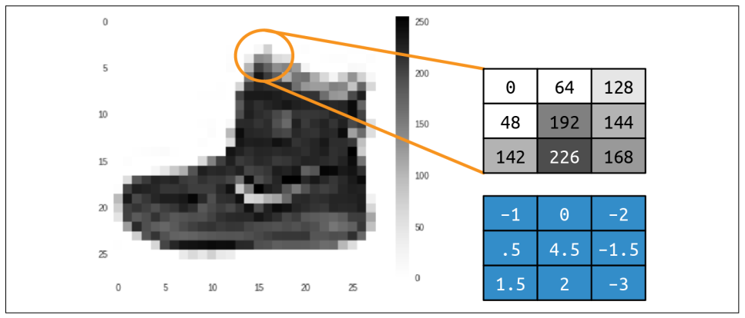
Image science 101: Convolutions
Here is a 3x3 convolution (lower matrix in blue) that can be applied to the MNIST Nike boot image. The convolution would be computed on each pixel of the source image.
WHY?
$$0×−1+64×0+128×−2+ \\ 48×.5+192×4.5+144×−1.5+$$
$$142×1.5+226×2+168×−3=577$$

Slide 11
Image science 101: Convolutions
What do you see in these images?
Vertical and horizontal features

Slide 12
Image science 101: Convolutions
How do we build convolutions that will allow us to find features in an image?
How do we know which matrices will extract the right sort of visual patterns that will make the neural network better able to match images to categories?
WE DON'T!!!
We make learning the convolutions part of the set of parameters that the neural network model has to learn

Slide 13
Image science 102: Pooling
Hi-resolution images have a lot of redundancy and so have information content that exceeds what is required to adequately represent various features
Pooling is a technique that reduces the size of an image while preserving the feature information (and may also have the side-effect of enhancing some features)

Slide 14
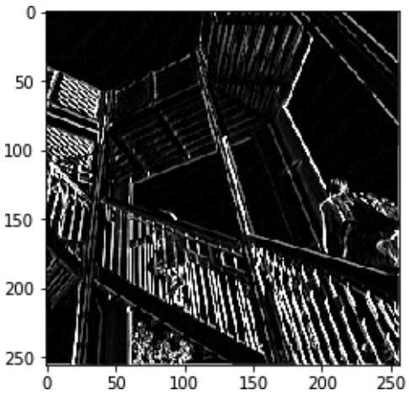
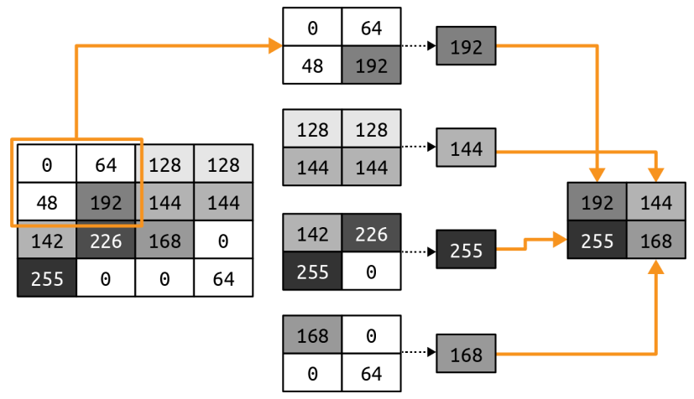
Image science 102: Max Pooling
Vertical filter followed by max pooling

Slide 15
A Programmer's Guide
ML Zero to Hero, Part 3

